Slide 1
LOGOS: engineering simulation software and R&D
ATOM EXPO, SOCHI 2022
Dmitry Fomichev
Director of R&D and mathematical modelling digital products, PhD
Block of Digitalization
State Atomic Energy ROSATOM | CIFRUM

Slide 2
World computer engineering
50%
of high-tech products are developed by using simulation modeling of parts of developed complex systems and products
MORE THAN 30%
of products are developed by using simulation modeling of low-scale analogues of developed systems and products
MORE THAN 15%
of products are developed by using full-scale simulation modeling of developed systems and products
5%
of products are developed by not using simulation modeling
Notes:
Экспертная оценка автора презентации

Slide 3









LOGOS
A multiphysics engineering simulation software
LOGOS
LOGOS
PREPOST
AERO−HYDRO
Design model preparation and results analysis
Simulation of processes in air, fluid, and gas media
LOGOS
ATOM
LOGOS
PLATFORM
LOGOS
LOGOS
Nuclear industry-designed solution for special cases simulation for nuclear industry enterprises
THERMAL
MECHANICAL
Design model and third-party software integration
Heat transfer and phase transition process simulation
Static and dynamic mechanical and strength process simulation
LOGOS
LOGOS
RESOURCE
DATA
LOGOS
Nuclear industry
Software / codes
ELECTROMAGNETICS
Resource characteristics simulation (based on the Resource software)
Project and design data management
Electromagnetic process simulation
LOGOS
THIRD-PARTY
software
NEUTRON
LOGOS
HYDROGEOLOGY
Neutronic characteristics simulation using diffusion and kinetic methods
Additional libraries
and frameworks
Surface runoff and subsurface fluid dynamics process simulation
3
Notes:
https://www.tadviser.ru/index.php/%D0%9F%D1%80%D0%BE%D0%B4%D1%83%D0%BA%D1%82:%D0%A0%D0%A4%D0%AF%D0%A6-%D0%92%D0%9D%D0%98%D0%98%D0%AD%D0%A4:_%D0%9F%D0%B0%D0%BA%D0%B5%D1%82_%D0%BF%D1%80%D0%BE%D0%B3%D1%80%D0%B0%D0%BC%D0%BC_%D0%9B%D0%BE%D0%B3%D0%BE%D1%81

Slide 4






Industrial applications
NUCLEAR
INDUSTRY
AVIATION
DEFENCE
AEROSPACE
AUTOMOTIVE TRANSPORTATION
ENERGY
Notes:
Отраслевое применение – страница 22 буклета

Slide 5






Support and services
TRAINING
TECHNICAL
SUPPORT
PILOT R&D
PROJECTS
TESTING
CONSULTING
AND R&D
SAAS
Advanced
professional training
programs
Pilot R&D projects under technical supporting specialists
Remote access to computing resources for independent testing of Logos software products
Scientific research using Logos software products
Cloud access to Logos software products
User technical support services
Notes:
http://logos.vniief.ru/services/#:~:text=%D0%9F%D0%BE%20%D1%82%D0%B5%D0%BB%D0%B5%D1%84%D0%BE%D0%BD%D1%83%208%20(800)%20555,%D0%B4%D0%BE%2017%3A00%20%D0%BF%D0%BE%20%D0%9C%D0%A1%D0%9A)

Slide 6
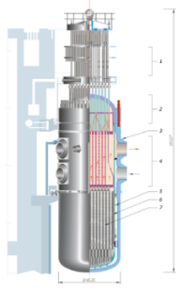
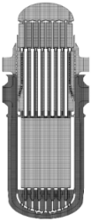
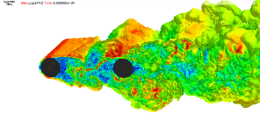
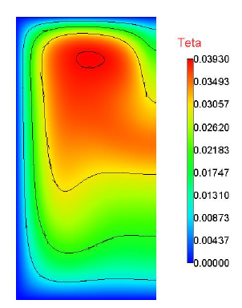
LOGOS as a part of Industry 4.0
Virtualizing design solution for justification of design equipment and facilities
Full-scale geometric CAD model
1
Development
Speeding up design solution justification process and making it cheaper
1
Experimental tests
on stands
Cutting down on (or even not doing then anymore) uninformative experiments (or not doing them on low-performance stands)
2
LOGOS
Discrete design
CAE model
AERO−HYDRO
2
Simulation of processes in air, fluid, and gas media
LOGOS
Full-scale qualification testing
Enhanced experiment quality
LOGOS
PREPOST
3
THERMAL
Design model component verification
Design model preparation and results analysis
3
Heat transfer and phase transition process simulation
LOGOS
Commercial use. Mass production
Condition forecasting, structure / equipment operation mode analysis
LOGOS
PLATFORM
Quantitative results for every point of structures /
equipment
4
MECHANICAL
Design model and third-party software projects integration
4
Static and dynamic robustness process simulation
Notes:
Презентация «Инженерное программное обеспечение», слайд 4, РИО 771-1.6/29-Рш от 03.06.2022
Картинки (дополнительно)
https://wiki2.info/%D0%91%D0%B0%D0%BB%D0%B0%D0%BA%D0%BE%D0%B2%D1%81%D0%BA%D0%B0%D1%8F_%D0%90%D0%AD%D0%A1
Пакет программ Логос для численного моделирования физических процессов, страница 34, Заключение №762-147-Рш от 21.07.2021, Разрешение №126-З от 21.07.2021
http://www.gidropress.podolsk.ru/files/publication/publication2013/documents/283.pdf

Slide 7

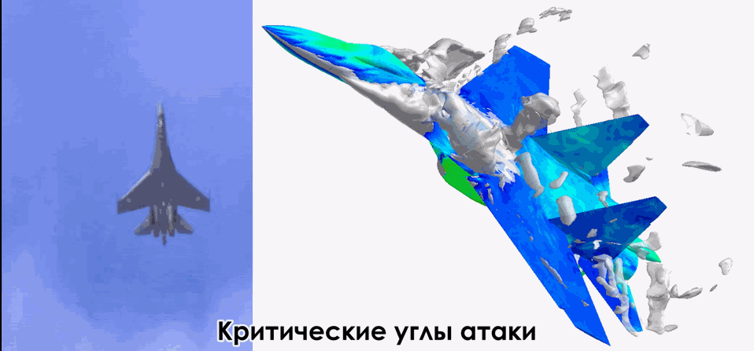

LOGOS AERO-HYDRO
Aircraft aerodynamic characteristics simulation
Simulation of processes in air, fluid, and gas media
Stationary and nonstationary flows
Incompressible
and compressible flows
Laminar and turbulent flows
Porous media flows
Multicomponent flows
Steam-gas mixture
Aircraft hydroacoustic characteristics simulation
Convective and conjugate
convective heat transfer
Free surface flows
…
Notes:
Презентация «Пакет программ Логос. Возможности и решаемые задачи», слайд 16 Рег.номер: 21-З от 05.06.2020

Slide 8

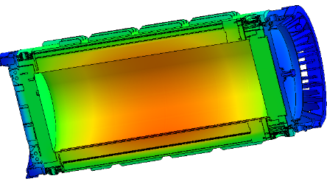
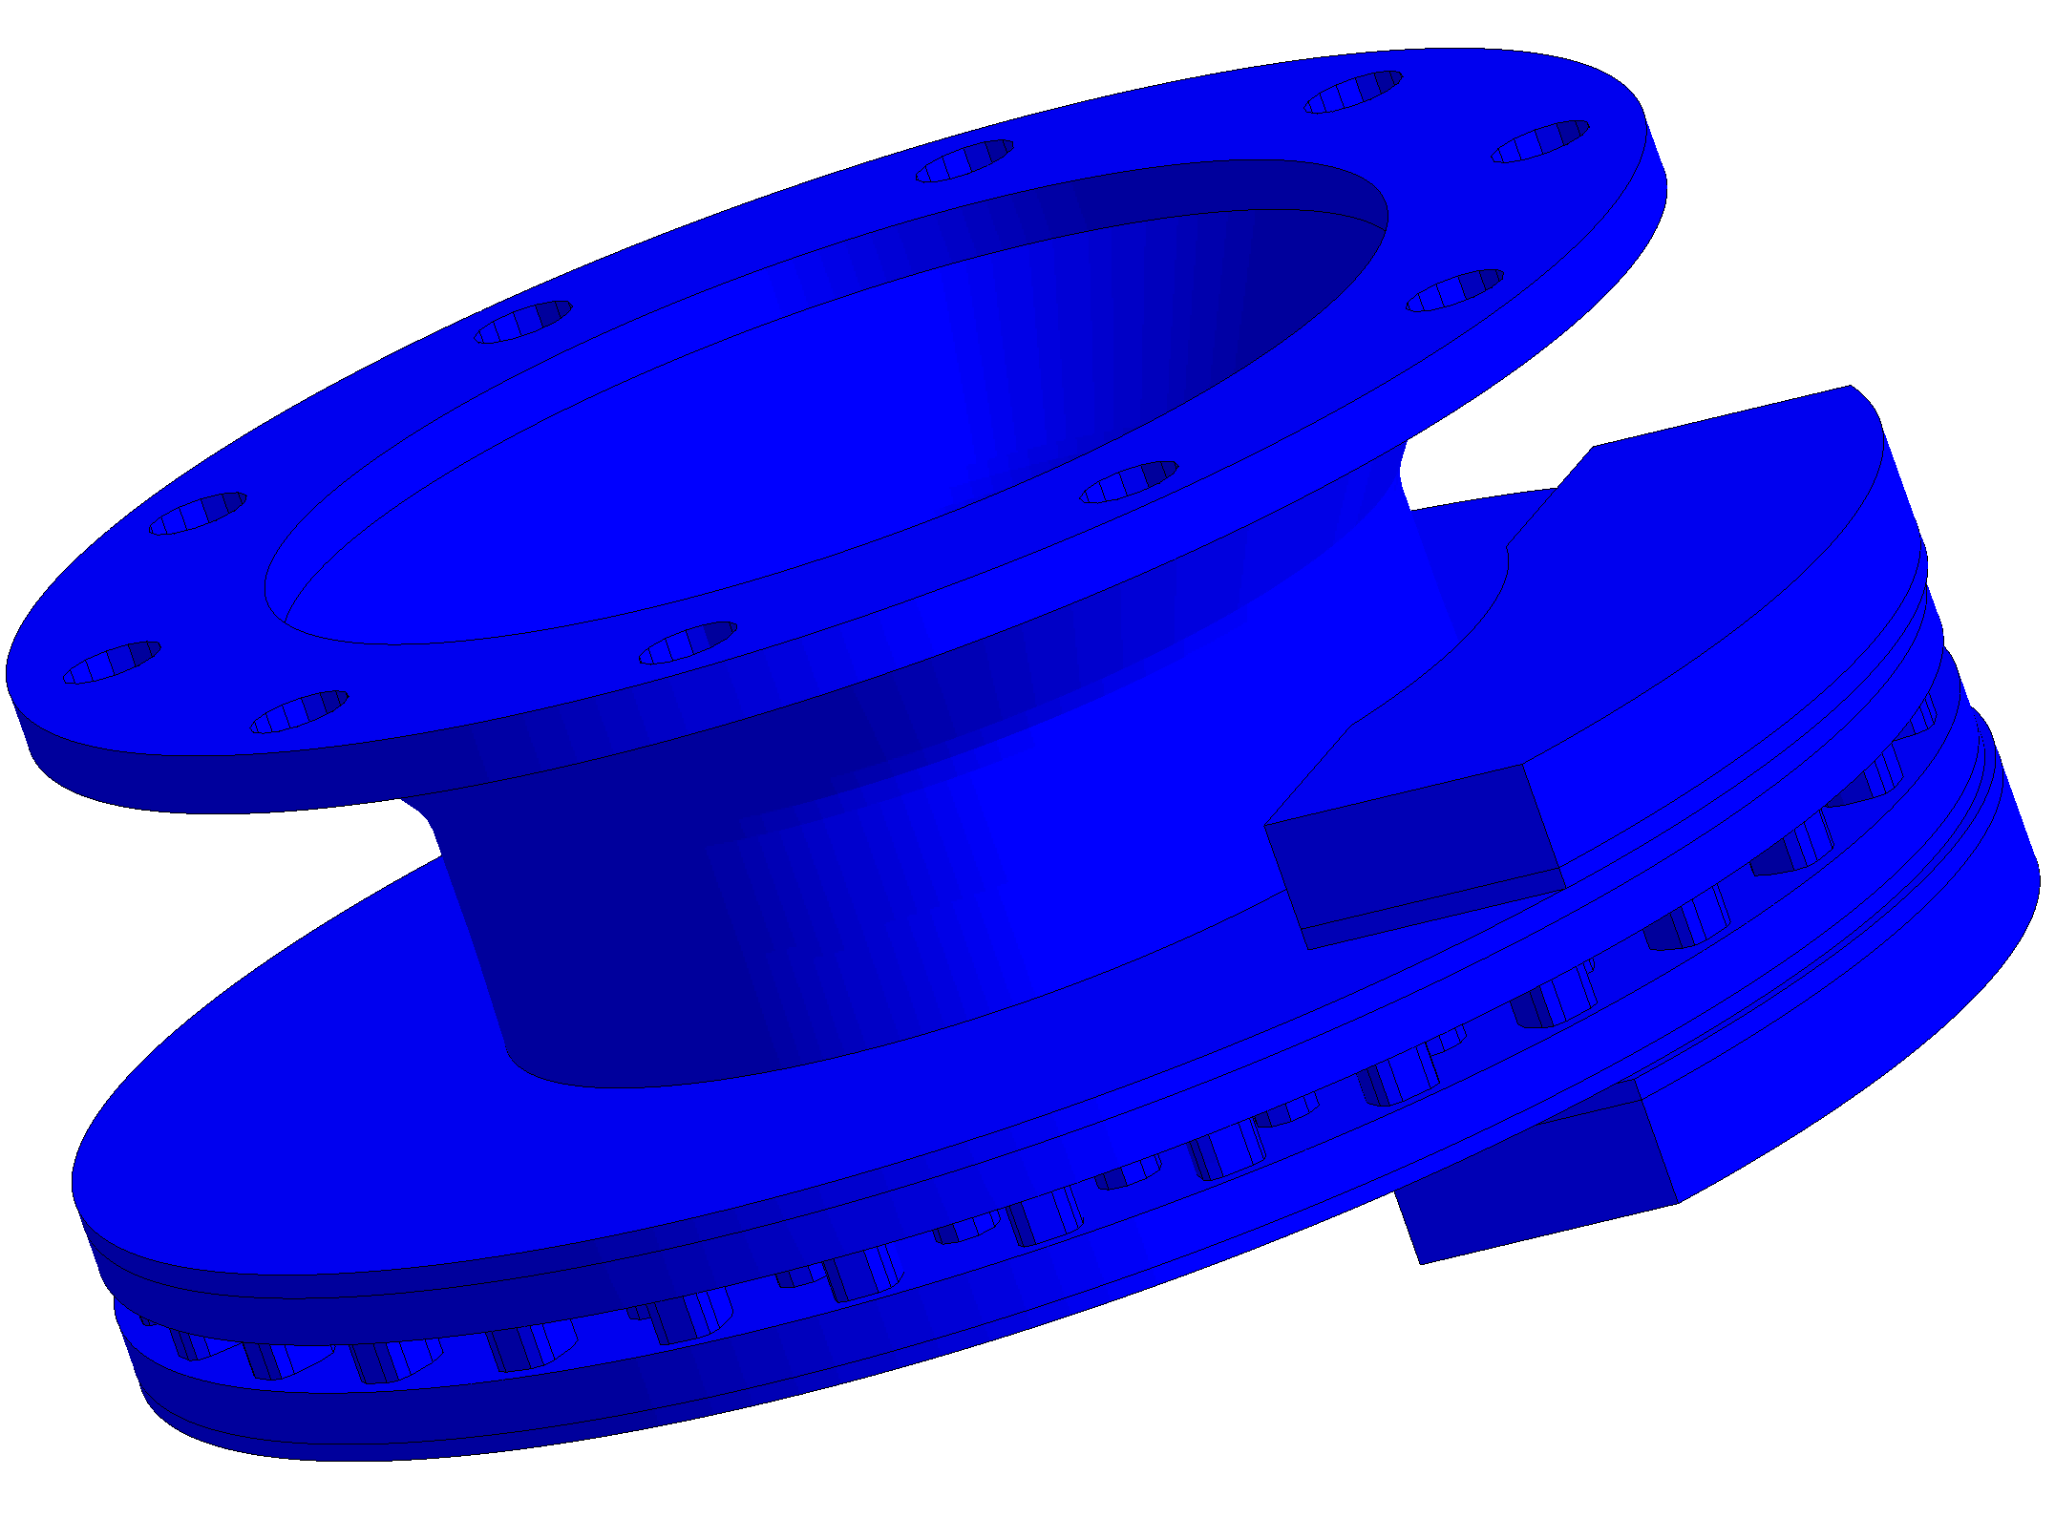
LOGOS THERMAL
Structure component thermal condition simulation
Heat transfer and phase transition process simulation
3D, 2D, axisymmetric
Radiation
heat transfer
Conjugate convective heat transfer
Randomly aligned grids
Explosives thermal decomposition and pyrotechnics combustion
Phase transitions
Moving object simulation
Moving objects,
morphing
Thermal resistance
…
Notes:
Страница 11, 3 брошюры Логос
Презентация «Пакет программ Логос для численного моделирования физических процессов», Заключение №762-147-Рш от 21.07.2021, Разрешение №126-З от 21.07.2021

Slide 9

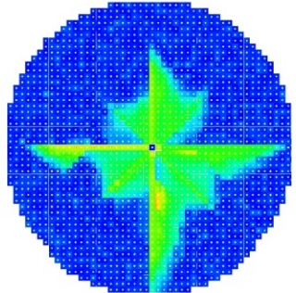
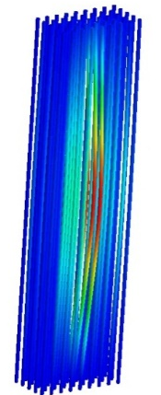
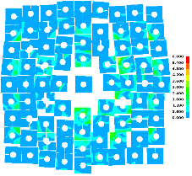
LOGOS MECHANICAL
Simulation of structure components robustness characteristics
Static and dynamic mechanical process simulation
Quasistatic robustness
Highly nonlinear dynamic robustness
Contact interaction
Smoothed particle hydrodynamics method
Slow dynamics
Modal analysis
Harmonic analysis
Broadband random vibration
Topology optimization
Coupled modelling (cfd + robustness)
Complex systems and machinery kinematics
…
Notes:
Обзор возможностей моделирования задач прочности с использованием пакета программ ЛОГОС, страница 8, открытый источник http://book.sarov.ru/wp-content/uploads/Supercomputing-15-2015-1.pdf http://logos.vniief.ru/products/platforma/ (стр. 1)
Презентация «Логос Прочность. Моделирование напряженнодеформированного состояния», слайд 45, РИО Разрешение №105-З от 19.04.2021, Заключение №762-1/25-Рш от 19.04.2021

Slide 10

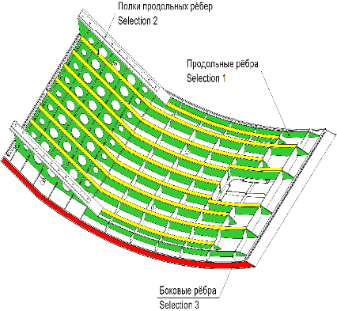
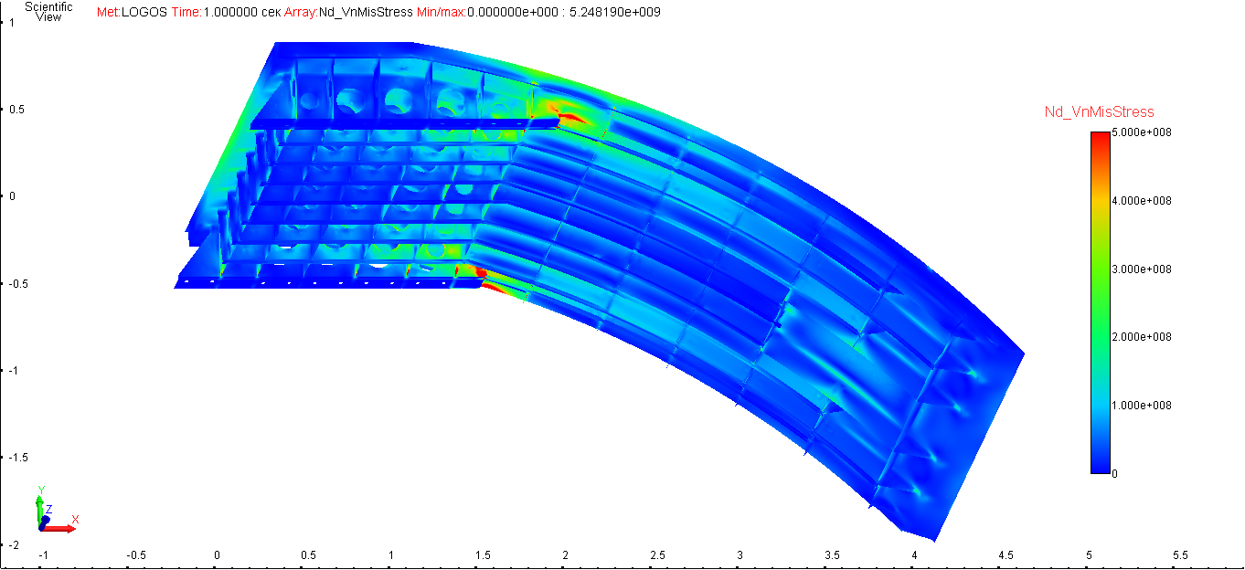
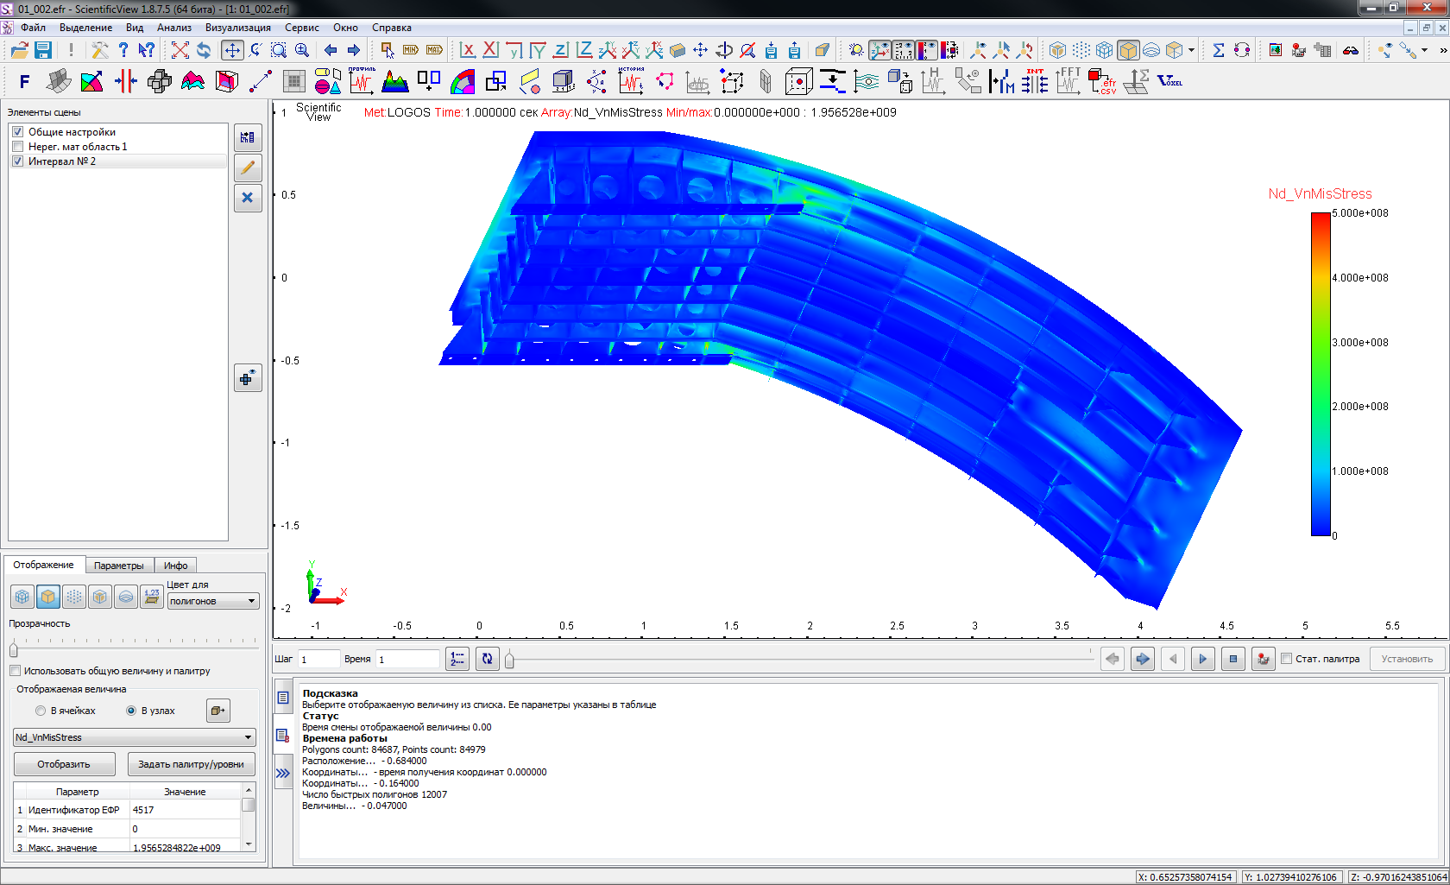
LOGOS PLATFORM
Design model and third-party software integration
Identifying the optimal structure component thickness
Structure strain-stress state simulation
Varying the structure frame components thickness to minimize the mass when it is necessary to limit the maximum allowable von Mises stress
Research optimization
Stress-mass relationship:
Hardware-software co-design
Longitudinal stiffener stringers
Longitudinal stiffeners
1D-3D coupled modelling
Target value
Parametric study
Lateral stiffeners
Optimized design
Notes:
Информация из открытых источников, включая страница 9, 27 брошюры про ЛОГОС, РИО 771-1/74-Рш от 13.12.2021

Slide 11
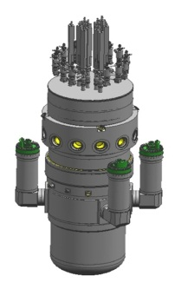
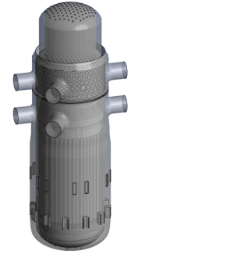
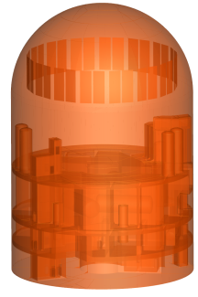
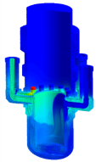
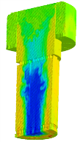
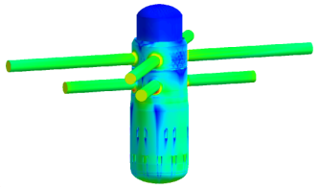

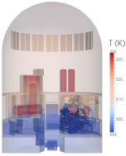
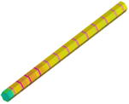
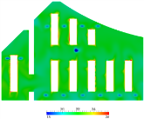
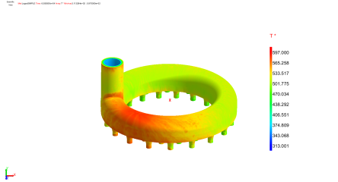
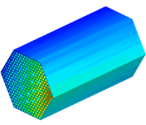
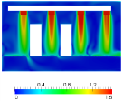

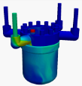
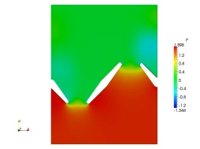
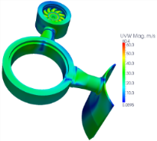

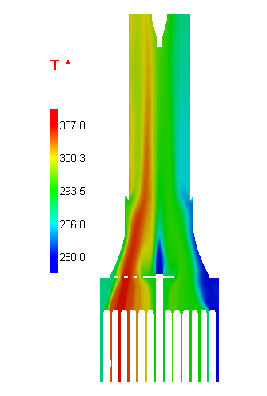
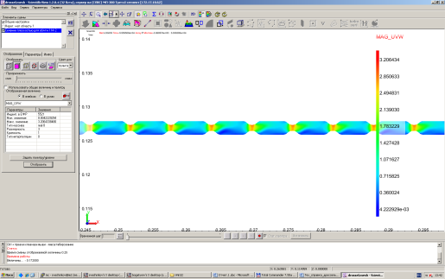
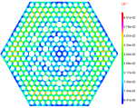
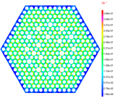

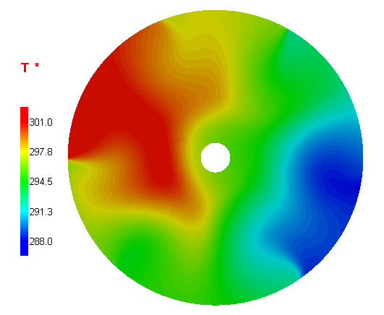
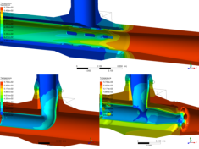
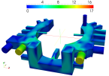
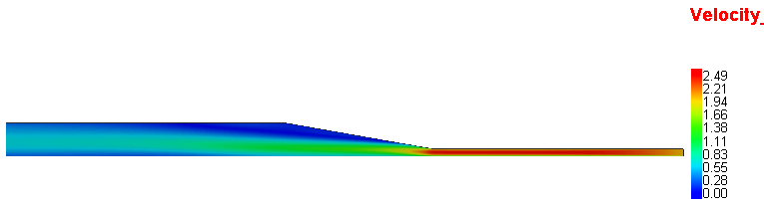


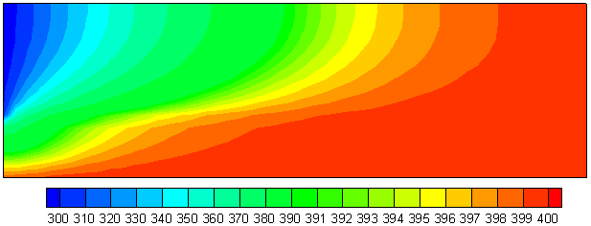

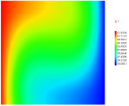
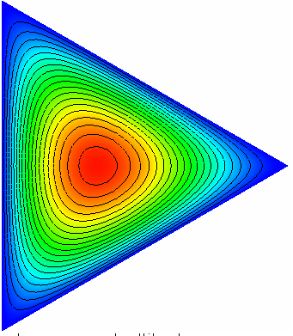

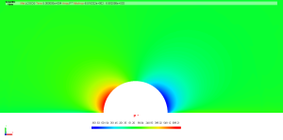
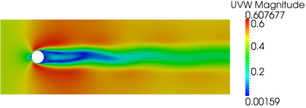
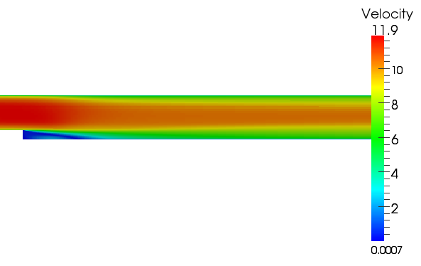
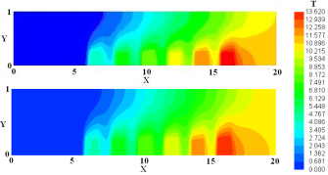
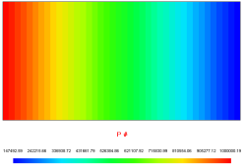


LOGOS
Verification and Certification
MARINE NUCLEAR PROPULSION PLANT
VVER REACTOR PLANT
VVER NPP UNIT REACTOR PLANT
ALREADY IMPLEMENTED PRODUCTS AND SYSTEMS
REACTOR PLANT COLD LEG
REACTOR PLANT HOT LEG
Heat exchanger
VVER Reactor Plant
FUEL ASSEMBLY
CONTAINMENT
ELECTRIC ROOM
REACTOR PLANT EQUIPMENT COMPONENTS
SPACE NPS DISCHARGE CHAMBER
ROTOR BLADES
THROTTLE
REACTOR-TO-NOZZLE JOINT
SPACER AND INTENSIFIER GRIDS
T-JOINT
STATIC PRESSURE CHAMBER
FUEL ASSEMBLY TOP NOZZLE
UNIQUE TASK
AND
MODEL SOLUTIONS
FLOW IN ASYMMETRIC DIFFUSER
NONISOTHERMAL FLOWS MIXING
ISOTHERMAL FLOW MIXING
SPLIT CHANNEL FLOW
FLOWS INSIDE OUTLETS
NATURAL CONVECTIVE HEAT TRANSFER IN SQUARE CAVITY
FLOW IN PIPES WITH DIFFERENT CROSS SECTIONS
FLOW AROUND STATIONARY BALL
FLOW AROUND CYLINDER
BACKWARD-FACING STEP FLOW
SOLID-STATE UNIT COOLING
FILTRATION THROUGH POROUS WALL
11

Slide 12

Thank you for your
attention!
Dmitry Fomichev
Director of R&D and mathematical modelling digital products, PhD
Block of Digitalization
State Atomic Energy ROSATOM | CIFRUM
Mob.: +7 925 617 4947
E-mail: DVaFomichev@rosatom.ru
NOVEMBER 2022

